Slide 1
Lecture 11
Indexing and Hashing

Slide 2
Outline
Basic Concepts
Ordered Indices
B+-Tree Index Files
B-Tree Index Files
Static Hashing
Dynamic Hashing
Comparison of Ordered Indexing and Hashing
Multiple-Key Access
Index Definition in SQL

Slide 3
Basic Concepts
Indexing mechanisms used to speed up access to desired data
  E.g., author catalog in library
Search Key - attribute or set of attributes used to look up records in a file
An index file consists of records (called index entries) of the form
Index files are typically much smaller than the original file
Two basic kinds of indices:
  Ordered indices: search keys are stored in sorted order
  Hash indices: search keys are distributed uniformly across “buckets” using a “hash function”
search-key
pointer

Slide 4
Index Evaluation Metrics
Access types supported efficiently. E.g.,
  Records with a specified value in the attribute
  Or records with an attribute value falling in a specified range of values
Access time
Insertion time
Deletion time
Space overhead

Slide 5
Ordered Indices
In an ordered index, index entries are stored sorted on the search key value.
  E.g., author catalog in library
Primary index: in a sequentially ordered file, the index whose search key specifies the sequential order of the file
  The search key of a primary index is usually but not necessarily the primary key
Secondary index: an index whose search key specifies an order different from the sequential order of the file
Index-sequential file: ordered sequential file with a primary index

Slide 6

Dense Index Files
Dense index — Index record appears for every search-key value in the file

Slide 7

Dense Index Files
Dense index — Index record appears for every search-key value in the file
* The above index stores, for each entry, a pointer to the first record.
* But index entries may store pointers to all records.

Slide 8

Sparse Index Files
Sparse Index: contains index records for only some search-key values
  Applicable when records are sequentially ordered on search-key

Slide 9
Sparse Index Files: Example
To locate a record with search-key value K we:
  Find index record with largest search-key value < K
  Search file sequentially starting at the record to which the index record points

Slide 10
Sparse Index Files
Less space and less maintenance overhead for insertions and deletions
Generally slower than dense index for locating records
Good tradeoff: sparse index with an index entry for every block in file
  Why?

Slide 11
Multilevel Index
If primary index does not fit in memory, access becomes expensive.
To reduce number of disk accesses to index records, treat primary index kept on disk as a sequential file and construct a sparse index on it
  Outer index – a sparse index of primary index
  Inner index – the primary index file
If even outer index is too large to fit in main memory, yet another level of index can be created, and so on.
Indices at all levels must be updated on insertion or deletion from the file.

Slide 12
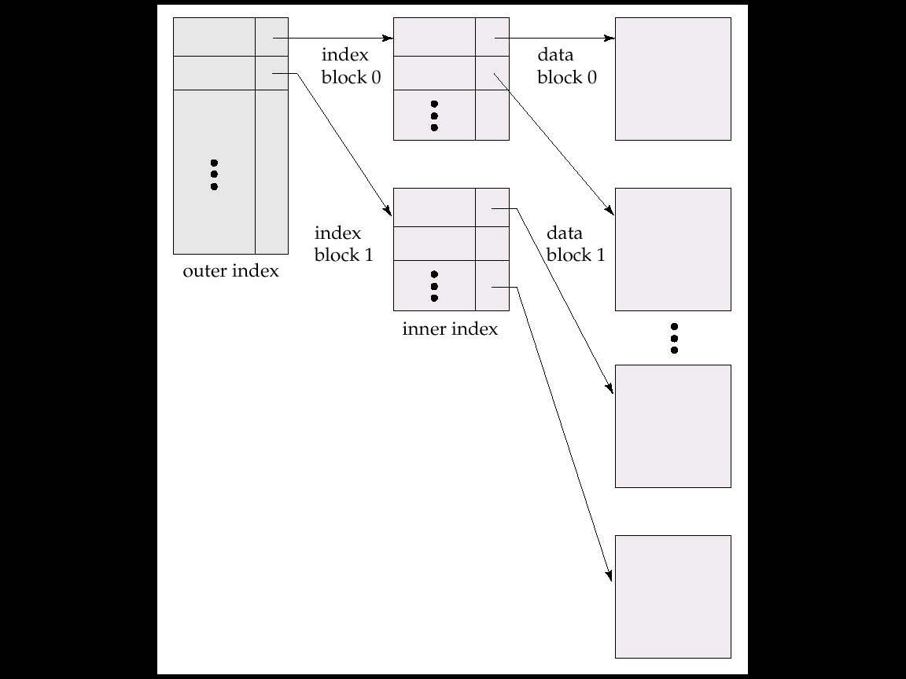
Multilevel Index (Cont.)

Slide 13
Index Update: Deletion
Single-level index deletion:
  Dense indices
    If deleted record was the only record in the file with its particular search-key value, the search-key is deleted from the index also.
    Otherwise:
      If the index record stores pointers to all records with the same search-key value, the system deletes the pointer to the deleted record from the index record
      Otherwise, the index record stores a pointer to only the first record with the search-key value. In this case, if the deleted record was the first record with the search-key values, the system updates the index record to point to the next record

Slide 14
1 | A
2 | A
3 | B
4 | C
5 | C
6 | C
A
B
C
1 | A
2 | A
4 | C
5 | C
6 | C
A
C
Delete Record 3
Index1
Index1
Records
Delete Record 4
Records
A
B
C
1 | A
2 | A
3 | B
5 | C
6 | C
A
B
C
Index1
Delete Record 4
A
B
C | null
Index2
Index2

Slide 15
Index Update: Deletion (Cont.)
Single-level index deletion:
  Sparse indices
    If the index does not contain an index record with the search-key value of the deleted record, nothing needs to be done to the index
    Otherwise:
      If the deleted record was the only record with the search key, it is deleted by replacing the entry in the index with the next search-key value in the file (in search-key order). If the next search-key value already has an index entry, the entry is deleted instead of being replaced
      Otherwise, if the index record for the search-key value points to the record being deleted, the system updates the index record to point to the next record with the same search-key value

Slide 16
1 | A
2 | A
3 | B
4 | C
5 | D
6 | D
Delete record 3, Index1 remains unchanged
A
C
1 | A
2 | A
3 | B
5 | D
6 | D
A
D
Index1
Delete Record 1, 2, 3
Delete Record 4
Index1
Records
Delete Record 5
Records
1 | A
2 | A
3 | B
6 | D
A
D
5 | D
6 | D
D
Index1
Index1
Records
Records

Slide 17
Index Update: Insertion
Single-level index insertion:
  Perform a lookup in the index using the search-key value appearing in the record to be inserted
  Dense indices
    If the search-key value does not appear in the index, insert it at the appropriate position
    Otherwise:
      If the index record stores pointers to all records with the same search-key value, the system adds a pointer to the new record to the index record
      Otherwise, the index record stores pointer to only the first record with the search-key value. The system then places the record being inserted after the other records with the same search-key values
  Sparse indices – if index stores an entry for each block of the file, no change needs to be made to the index unless a new block is created. In this case, the first search-key value appearing in the new block is inserted into the index
Multilevel insertion (as well as deletion) algorithms are simple extensions of the single-level algorithms

Slide 18

Secondary Indicies
Index record points to a bucket that contains pointers to all the actual records with that particular search-key value.
Secondary indices have to be dense

Slide 19
Secondary Indices
Frequently, one wants to find all the records whose values in a certain field (which is not the search-key of the primary index) satisfying some condition
  Example 1: In the instructor (ID, name, dept_name, salary) stored sequentially by ID, we may want to find all instructors in a particular department
  Example 2: as above, but where we want to find all instructors with a specified salary or with salary in a specified range of salary values.
We can have a secondary index with an index record for each search-key value; index record points to a bucket that contains pointers to all the actual records with that particular search-key value

Slide 20
Primary and Secondary Indices
Secondary indices have to be dense.
Indices offer substantial benefits when searching for records.
Updating indices imposes overhead on database modification.
  When a file is modified, every index on the file must be updated.
Sequential scan using primary index is efficient, but a sequential scan using a secondary index is expensive.
  Each record access may fetch a new block from disk.

Slide 21
B⁺-Tree Index Files
B⁺-tree indices are an alternative to indexed-sequential
files.
Disadvantage of indexed-sequential files:
  Performance degrades as file grows, since many overflow blocks get created.
  Periodic reorganization of entire file is required
Advantage of B⁺-tree index files
  Can automatically reorganize itself with small, local changes, in the face of insertions and deletions.
  Reorganization of entire file is not required to maintain performance
Disadvantage of B⁺-trees: extra insertion and deletion overhead, space overhead
Advantages of B⁺-trees outweigh disadvantages, and they are used extensively

Slide 22

B⁺-Tree Index Files

Slide 23
B⁺-Tree Index Files (Cont.)
A B⁺-tree is a rooted tree satisfying the following properties:
  All paths from root to leaf are of the same length
  Each node that is not a root nor a leaf has between ⎡n/2⎤ and n children
    e.g., n=5, every inner node has 3~5 children
  A leaf node has between ⎡(n–1)/2⎤ and n–1 values
    e.g., n=5, every leaf node has 2~4 values
  Special cases:
    If the root is not a leaf, it has at least 2 children
    If the root is a leaf (that is, there are no other nodes in the tree), it can have between 0 and (n–1) values

Slide 24
B⁺-Tree Node Structure
Typical node
  K_{i} are the search-key values
  P_{i} are pointers to children (for non-leaf nodes) or pointers to records or buckets of records (for leaf nodes)
The search-keys in a node are ordered
K₁ < K₂ < K₃ < . . . < K_{n–1}

Slide 25

Leaf Nodes in B⁺-Trees
Properties of a leaf node:
  For i = 1, 2, . . ., n–1, pointer P_{i} either points to a file record with search-key value K_{i}
  If L_{i}, L_{j} are leaf nodes and i < j, L_{i}’s search-key values are less than or equal to L_{j}’s search-key values
  P_{n} points to next leaf node in search-key order

Slide 26
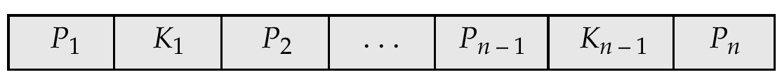
Non-Leaf Nodes in B⁺-Trees
Non leaf nodes form a multi-level sparse index on the leaf nodes. For a non-leaf node with n pointers:
  All the search-keys in the subtree to which P₁ points are less than K₁
  All the search-keys in the subtree to which P_{n} points are greater than or equal to K_{n-1}
  For 2 ≤ i ≤ n – 1, all the search-keys in the subtree to which P_{i} points have values greater than or equal to K_{i–1} and less than K_{i}
Search key values
that < K1
Search key values
that >=K1 and <K2
Search key values
that >=Kn-1

Slide 27

Example of a B⁺-tree
B⁺-tree for instructor file (n = 6)
Leaf nodes must have between 2 and 4 values
(⎡(n–1)/2⎤ and n –1, with n = 5)
Non-leaf nodes other than root must have between 3 and 5 children (⎡(n/2)⎤ and n with n =5)
Root must have at least 2 children

Slide 28
Observations about B⁺-trees
Since the inter-node connections are done by pointers, “logically” close blocks need not be “physically” close.
The non-leaf levels of the B⁺-tree form a hierarchy of sparse indices
The B⁺-tree contains a relatively small number of levels.
  If there are K search-key values in the file, the tree height is no more than ⎡ log_{⎡n/2⎤}(K)⎤
  thus searches can be conducted efficiently.
Insertions and deletions to the main file can be handled efficiently, as the index can be restructured in logarithmic time.

Slide 29

Queries on B⁺-Trees
Find all records with a search-key value of k
  C=root
  While C is not a leaf node {
    Let i be least value s.t. V ≤ K_{i}.
    If no such exists, set C = last non-null pointer in C
    Else { if (V= K_{i} ) Set C = P_{i +1} else set C = P_{i}}
    }
  Let i be least value s.t. K_{i} = V
  If there is such a value i, follow pointer P_{i} to the desired record.
  Else no record with search-key value k exists.

Slide 30
Queries on B⁺⁻Trees (Cont.)
In processing a query, a path is traversed in the tree from the root to some leaf node
  If there are K search-key values in the file, the path is no longer than ⎡ log_{⎡n/2⎤}(K)⎤
A node is generally the same size as a disk block, typically 4 kilobytes, and n is typically around 100 (40 bytes per index entry)
With 1 million search key values and n = 100, at most log₅₀(1,000,000) = 4 nodes are accessed in a lookup
Contrast this with a balanced binary tree with 1 million search key values — around 20 nodes are accessed in a lookup
  Above difference is significant since every node access may need a disk I/O, costing around 20 milliseconds!
Notes:
log₅₀(1,000,000)=3.53

Slide 31
B⁺-Tree File Organization
Index file degradation problem is solved by using B⁺-Tree indices.
Data file degradation problem is solved by using B⁺-Tree File Organization.
The leaf nodes in a B⁺-tree file organization store records, instead of pointers.
Leaf nodes are still required to be half full
  Since records are larger than pointers, the maximum number of records that can be stored in a leaf node is less than the number of pointers in a nonleaf node.
Insertion and deletion are handled in the same way as insertion and deletion of entries in a B⁺-tree index.

Slide 32
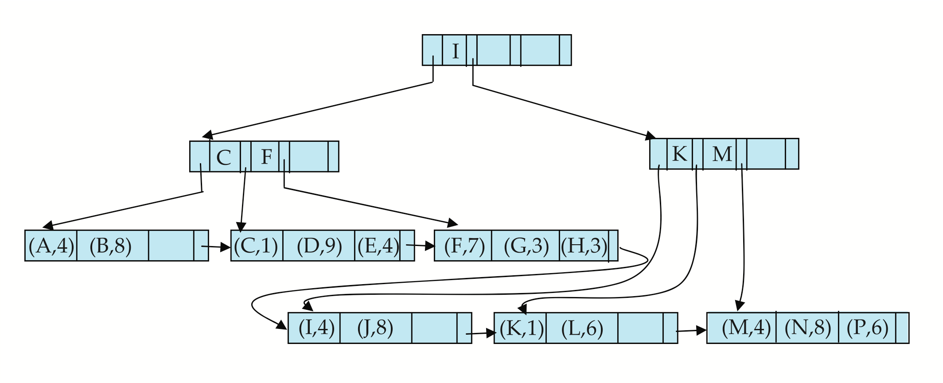

B⁺-Tree File Organization (Cont.)
Example of B⁺-tree File Organization
Good space utilization important since records use more space than pointers.
To improve space utilization, involve more sibling nodes in redistribution during splits and merges
  Involving 2 siblings in redistribution (to avoid split / merge where possible) results in each node having at least entries

Slide 33
B-Tree Index Files
Similar to B⁺-tree, but B-tree allows search-key values to appear only once; eliminates redundant storage of search keys
Search keys in nonleaf nodes appear nowhere else in the B-tree; an additional pointer field for each search key in a nonleaf node must be included

Slide 34
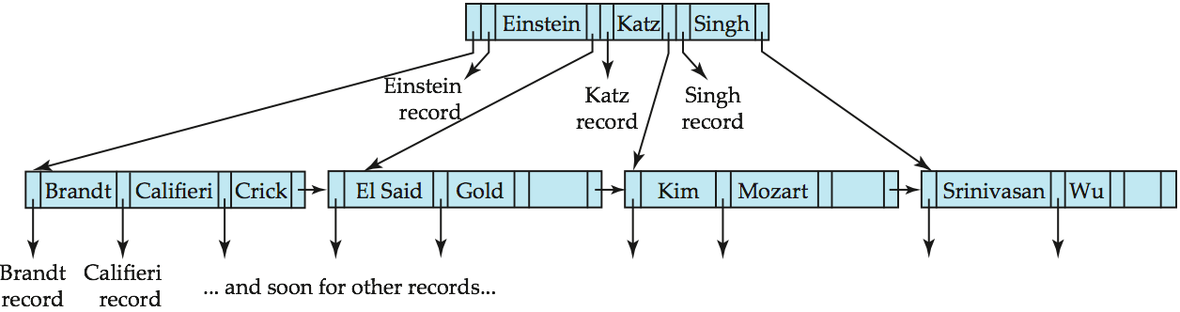
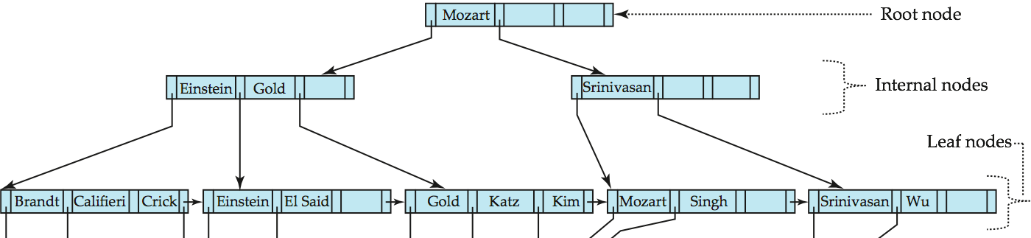
B-Tree Index File Example
B-tree (above) and B+-tree (below) on same data

Slide 35
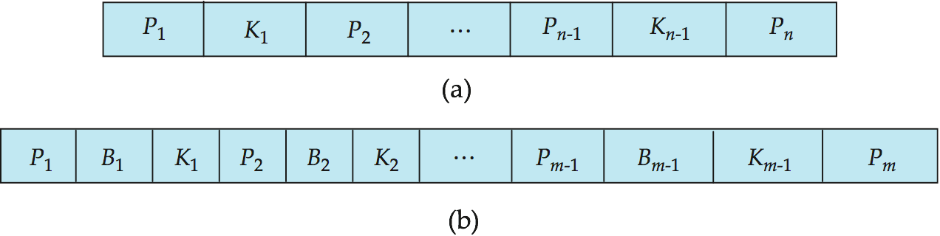
Generalized B-tree leaf node ((a) in the following figure)
Nonleaf node – pointers B_{i} are the bucket or file record pointers ((b) in the above figure)

Slide 36
B-Tree Index Files (Cont.)
Advantages of B-Tree indices:
  May use less tree nodes than a corresponding B⁺-Tree
  Sometimes possible to find search-key value before reaching leaf node
Disadvantages of B-Tree indices:
  Only small fraction of all search-key values are found early
  Non-leaf nodes are larger, so fan-out is reduced. Thus B-Trees typically have greater depth than corresponding B⁺-Tree
  Insertion and deletion more complicated than in B⁺-Trees
  Implementation is harder than B⁺-Trees
Typically, advantages of B-Trees do not outweigh disadvantages

Slide 37
Static Hashing
A bucket is a unit of storage containing one or more records (a bucket is typically a disk block).
In a hash file organization we obtain the bucket of a record directly from its search-key value using a hash function.
  Hash function h is a function from the set of all search-key values K to the set of all bucket addresses B.
  Hash function is used to locate records for access, insertion as well as deletion.
Records with different search-key values may be mapped to the same bucket; thus entire bucket has to be searched sequentially to locate a record.

Slide 38
Example of Hash File Organization
Hash file organization of instructor file, using dept_name as key (Figure in next slide)
There are 10 buckets.
The binary representation of the ith character is assumed to be the integer i.
The hash function returns the sum of the binary representations (ASCII, alphabetic order, etc.) of the characters modulo 10
  E.g. h(Music) = 1 h(History) = 2 h(Physics) = 3
  h(Elec. Eng.) = 3

Slide 39

Example of Hash File Organization (Cont.)
Hash file organization of instructor file, using dept_name as key

Slide 40
Hash Functions
The worst hash function maps all search-key values to the same bucket; this makes access time proportional to the number of search-key values in the file.
An ideal hash function is uniform, i.e., each bucket is assigned the same number of search-key values from the set of all possible values
An ideal hash function is random, so each bucket will have the same number of records assigned to it irrespective of the actual distribution of search-key values in the file
Typical hash functions perform computation on the internal binary representation of the search-key
  For example, for a string search-key, the binary representations of all the characters in the string could be added and the sum modulo the number of buckets could be returned

Slide 41
Handling of Bucket Overflows
Bucket overflow can occur because of
  Insufficient buckets.
  Skew in distribution of records.
  This can occur due to two reasons:
    Multiple records have the same search-key value
    Chosen hash function produces non-uniform distribution of key values
Although the probability of bucket overflow can be reduced, it cannot be eliminated; it is handled by using overflow buckets.

Slide 42
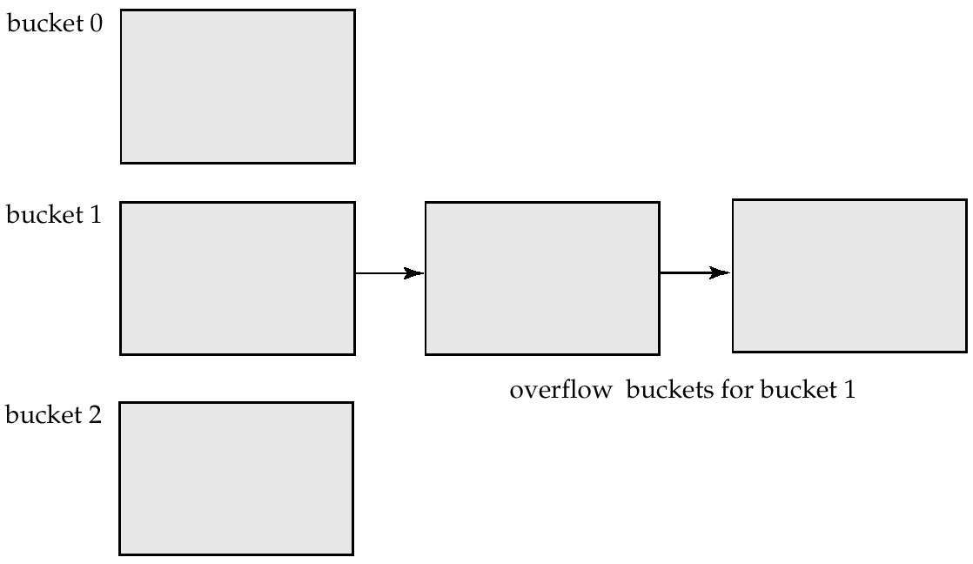
Handling of Bucket Overflows (Cont.)
Overflow chaining – the overflow buckets of a given bucket are chained together in a linked list

Slide 43
Hash Indices
Hashing can be used not only for file organization, but also for index-structure creation
A hash index organizes the search keys, with their associated record pointers, into a hash file structure
Strictly speaking, hash indices are always secondary indices
  If the file itself is organized using hashing, a separate primary hash index on it using the same search-key is unnecessary
  However, we use the term hash index to refer to both secondary index structures and hash organized files

Slide 44
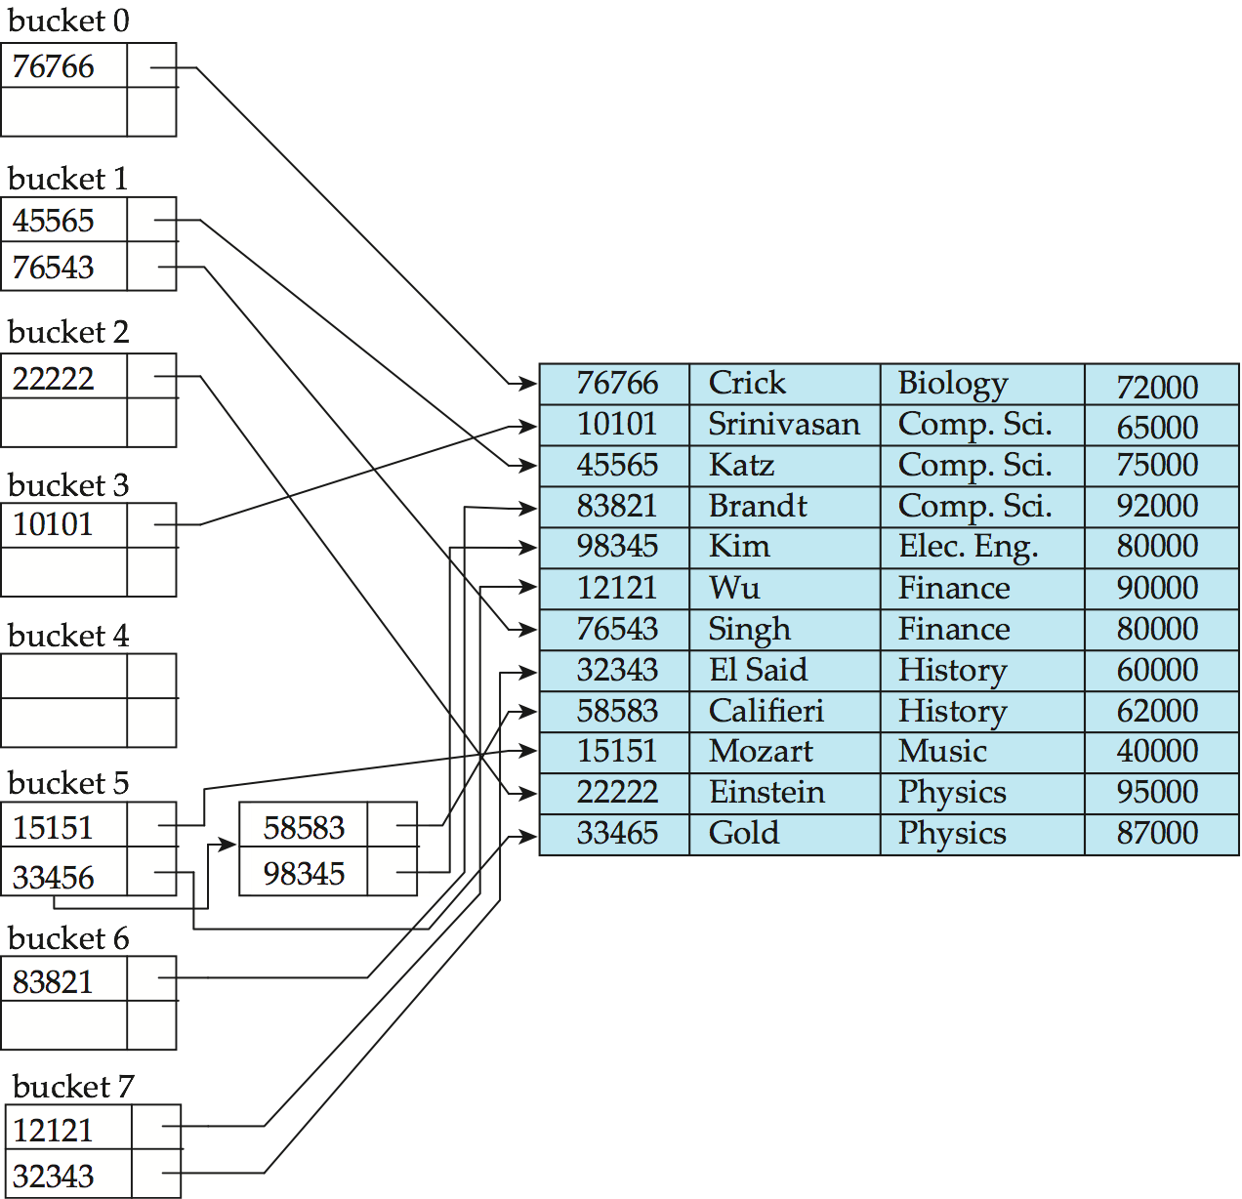
Example of Hash Index
hash index on instructor, on attribute ID

Slide 45
Deficiencies of Static Hashing
In static hashing, function h maps search-key values to a fixed set of B of bucket addresses
  Databases grow with time. If initial number of buckets is too small, performance will degrade due to too much overflows
  If file size at some point in the future is anticipated and number of buckets allocated accordingly, significant amount of space will be wasted initially
  If database shrinks, again space will be wasted
  One option is periodic re-organization of the file with a new hash function, but it is very expensive
These problems can be avoided by using techniques that allow the number of buckets to be modified dynamically – Dynamic Hashing

Slide 46
Dynamic Hashing
Good for database that frequently grows and shrinks in size
Allows the hash function to be modified dynamically
Extendable hashing – one form of dynamic hashing
  Hash function generates values over a large range — typically b-bit integers, with b = 32
  At any time use only a prefix of the hash function to index into a table of bucket addresses
  Let the length of the prefix be i bits, 0 ≤ i ≤ 32
  Bucket address table size = 2^{i}. Initially i = 0
  Value of i grows and shrinks as the size of the database grows and shrinks
  Multiple entries in the bucket address table may point to a bucket
  Thus, actual number of buckets is < 2^{i}
    The number of buckets also changes dynamically due to coalescing and splitting of buckets

Slide 47
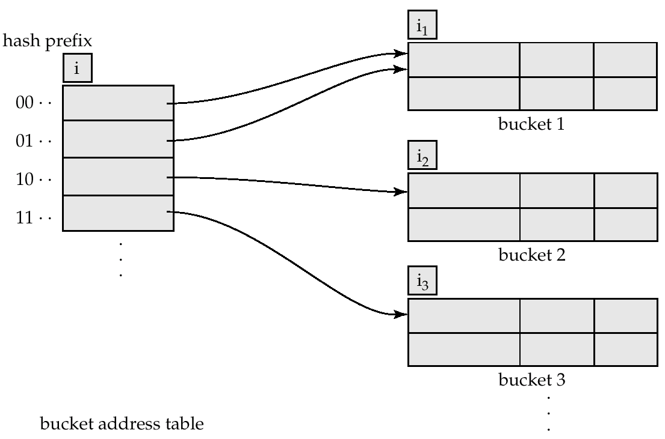
General Extendable Hash Structure
In this structure, i₂ = i₃ = i, whereas i₁ = i – 1

Slide 48
Use of Extendable Hash Structure
Each bucket j stores a value i_{j} ; all the entries that point to the same bucket have the same values on the first i_{j} bits. The number of bucket address table entries that point to bucket j is 2^(i-i_{j})
To locate the bucket containing search-key K_{l} :
  1. Compute h ( K_{l} ) = X
  2. Use the first i high order bits of X as a displacement into bucket address table, and follow the pointer to appropriate bucket
To insert a record with search-key value K_{l}
  Follow the same procedure as look-up and locate the bucket, say j
  If there is room in the bucket j insert record in the bucket
  Else the bucket must be split and insertion re-attempted (next slide)
    Overflow buckets used instead in some cases

Slide 49
Updates in Extendable Hash Structure
To split a bucket j when inserting record with search-key value K_{l} :
If i > i_{j} (more than one pointer to bucket j)
  Allocate a new bucket z, and set i_{j} and i_{z} to the old i_{j} + 1
  Make the second half of the bucket address table entries pointing to j to point to z
  Rehash each record in bucket j and reinsert each record into bucket j or bucket z
  Recompute new bucket for K_{l} and insert record in the bucket (further splitting is required if the bucket is still full)
If i = i_{j} (only one pointer to bucket j)
  Increment i and double the size of the bucket address table
  Replace each entry in the table by two entries that point to the same bucket
  Recompute new bucket address table entry for K_{l}
  Now i > i_{j} so use the first case above
When inserting a value, if the bucket is full after several splits (that is, i reaches some limit b) create an overflow bucket instead of splitting bucket entry table further

Slide 50
Updates in Extendable Hash Structure (Cont.)
To delete a key value,
  Locate it in its bucket and remove it
  The bucket itself can be removed if it becomes empty (with appropriate updates to the bucket address table)
  Coalescing of buckets can be done (can coalesce only with a “buddy” bucket having same value of i_{j} and same i_{j} –1 prefix, if it is present)
  Decreasing bucket address table size is also possible
    Note: decreasing bucket address table size is an expensive operation and should be done only if number of buckets becomes much smaller than the size of the table

Slide 51
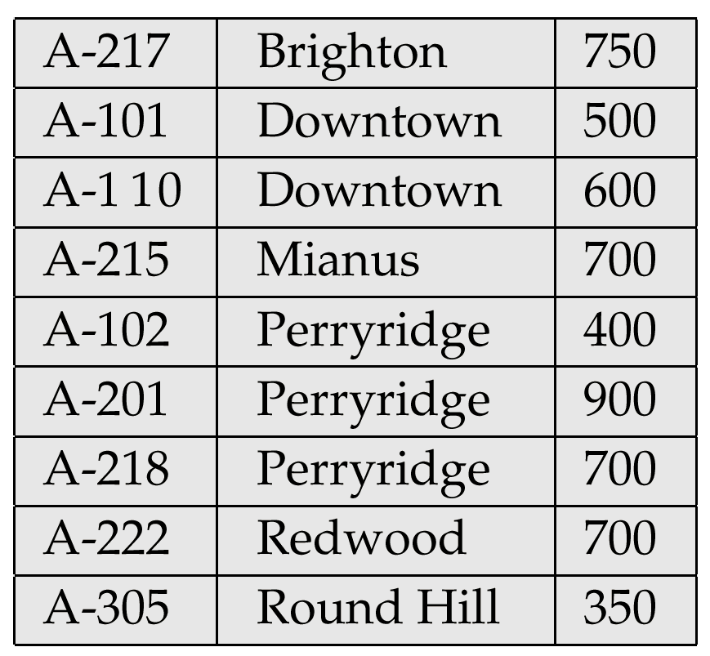
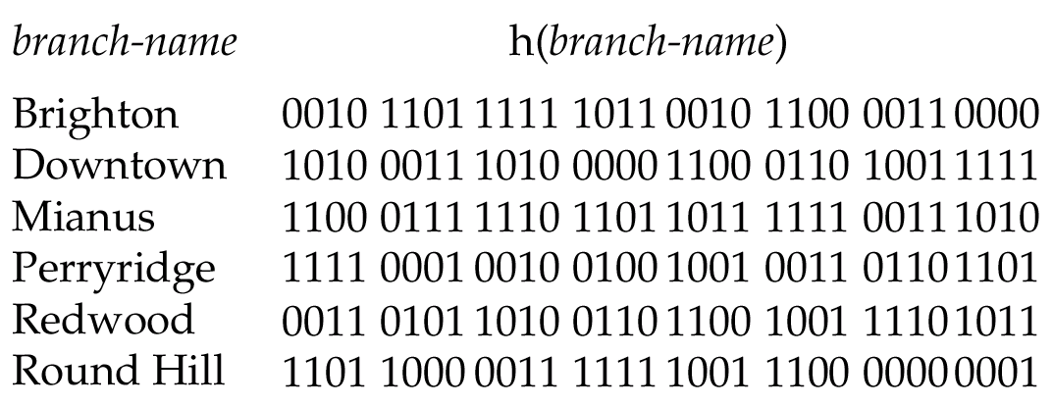
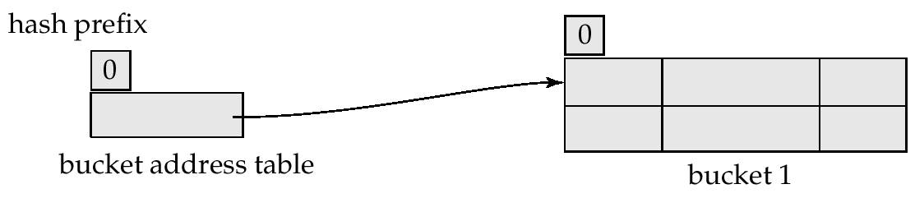
Use of Extendable Hash Structure: Example
i_{j}
i
j
Initial Hash structure, bucket size = 2

Slide 52
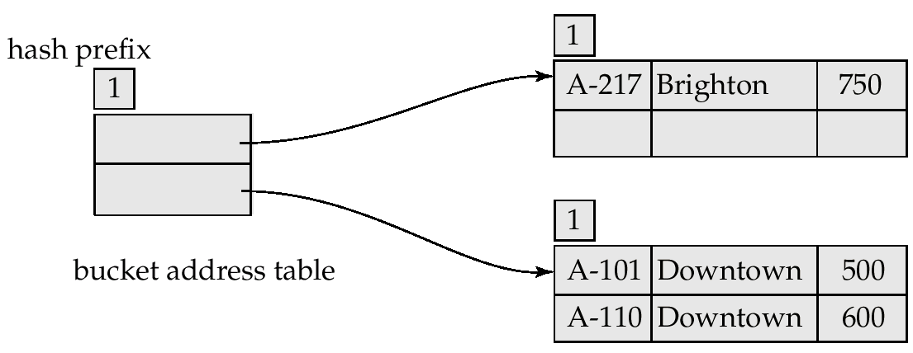
Example (Cont.)
Hash structure after insertion of one Brighton and two Downtown records

Slide 53
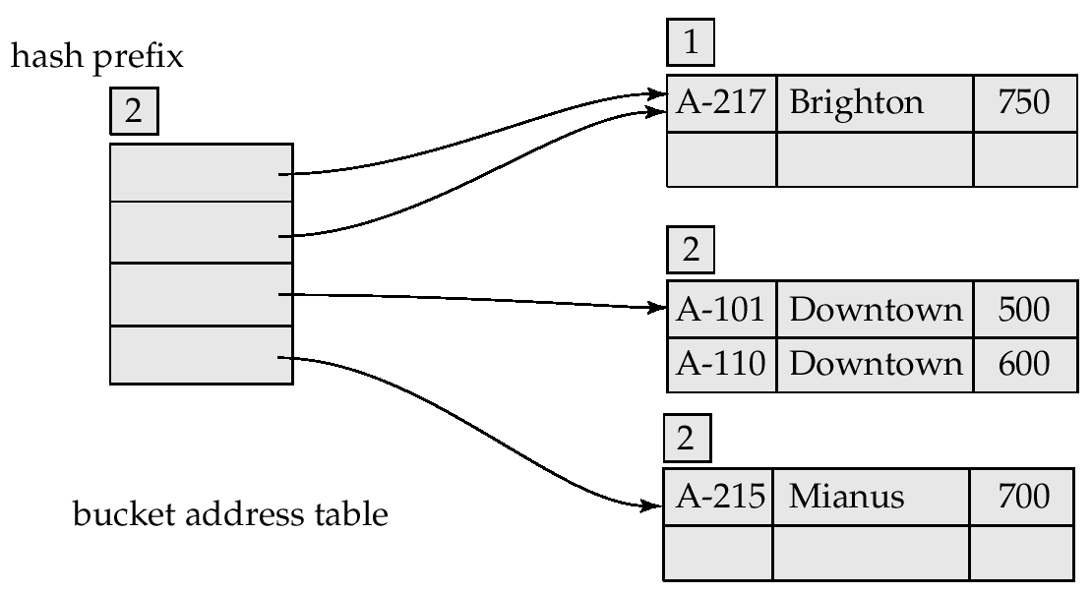
Example (Cont.)
Hash structure after insertion of Mianus record

Slide 54
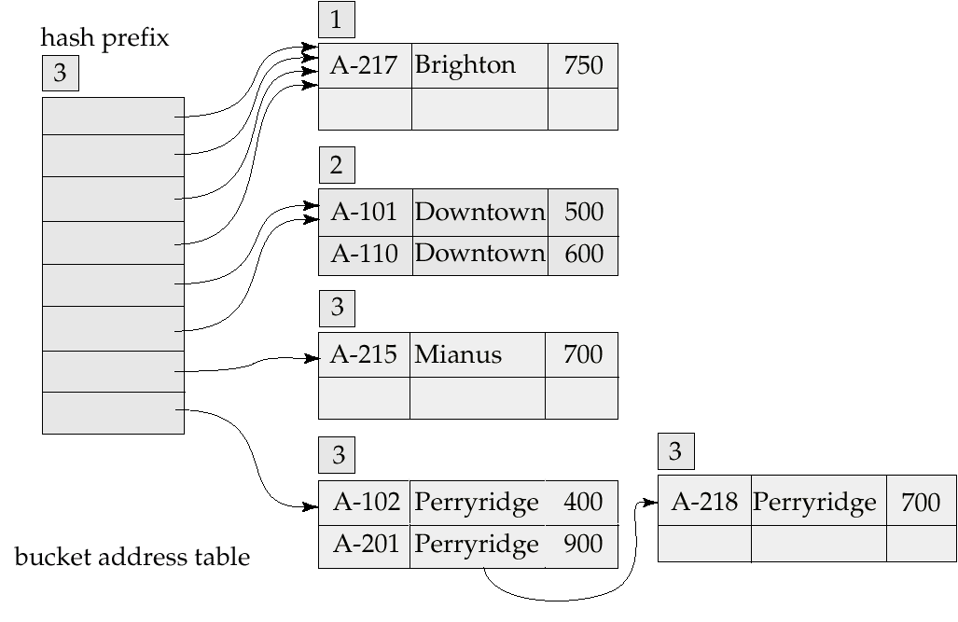
Example (Cont.)
Hash structure after insertion of three Perryridge records

Slide 55
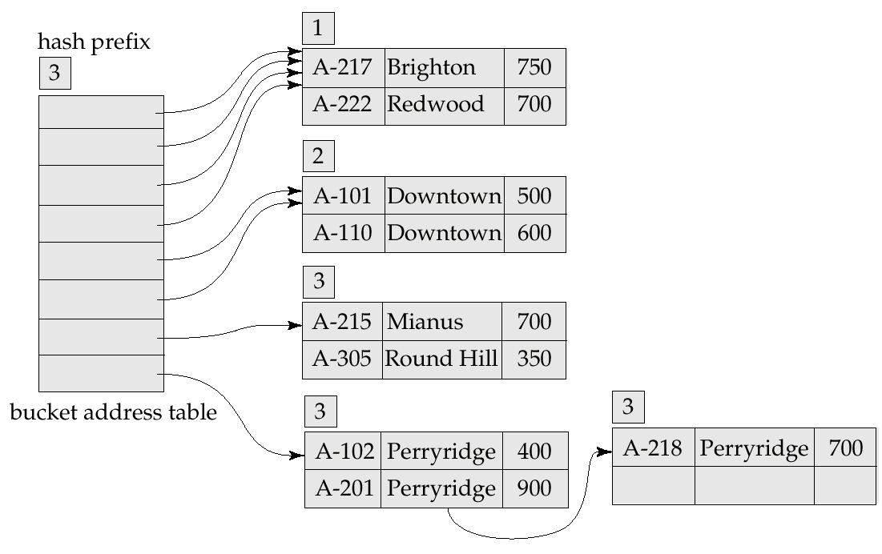
Example (Cont.)
Hash structure after insertion of Redwood and Round Hill records

Slide 56
Extendable Hashing vs. Other Schemes
Benefits of extendable hashing:
  Hash performance does not degrade with growth of file
  Minimal space overhead
Disadvantages of extendable hashing
  Extra level of indirection to find desired record
  Bucket address table may itself become very big (larger than memory)
    Need a tree structure to locate desired record in the structure!
  Changing size of bucket address table is an expensive operation
But the advantages outweigh the disadvantages

Slide 57
Comparison of Ordered Indexing and Hashing
Cost of periodic re-organization
Relative frequency of insertions and deletions
Average access time
Expected type of queries:
  Hashing is generally better at retrieving records having a specified value of the key
  If range queries are common, ordered indices are to be preferred

Slide 58
Multiple-Key Access
Use multiple indices for certain types of queries
Example:
  select ID
  from instructor
  where dept_name = “Finance” and salary = 80000
Possible strategies for processing query using indices on single attributes:
  1. Use index on dept_name to find instructors with department name Finance; test salary = 80000
  2. Use index on salary to find instructors with a salary of $80000; test dept_name = “Finance”.
  3. Use dept_name index to find pointers to all records pertaining to the “Finance” department. Similarly use index on salary. Take intersection of both sets of pointers obtained.

Slide 59
Indices on Multiple Attributes
Suppose we have an index on combined search-key
(dept_name, salary)
With the where clause
where dept_name = “Finance” and salary = 80000
the index on (dept_name, salary) will fetch only records that satisfy both conditions
Using separate indices results in less efficiency — we may fetch many records (or pointers) that satisfy only one of the conditions
Can also efficiently handle
where dept_name = “Finance” and salary < 80000
But cannot efficiently handle
where dept_name < “Finance” and balance = 80000
May lead to many I/O operations

Slide 60
Grid Files
Structure used to speed the processing of general multiple search-key queries involving one or more comparison operators
The grid file has a single grid array and one linear scale for each search-key attribute. The grid array has number of dimensions equal to number of search-key attributes
Multiple cells of grid array can point to same bucket
To find the bucket for a search-key value, locate the row and column of its cell using the linear scales and follow pointer

Slide 61
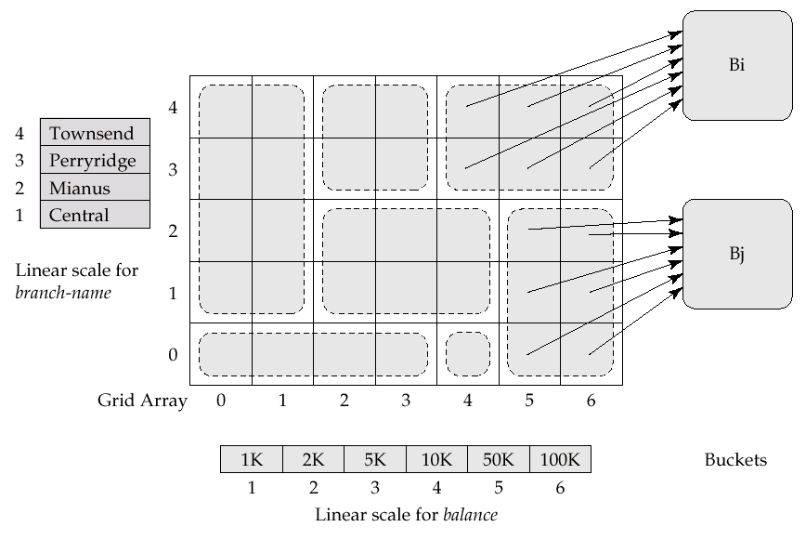
Example Grid File for account

Slide 62
Queries on a Grid File
A grid file on two attributes A and B can handle queries of all following forms with reasonable efficiency
  (a₁ ≤ A ≤ a₂)
  (b₁ ≤ B ≤ b₂)
  (a₁ ≤ A ≤ a₂ ∧ b₁ ≤ B ≤ b₂),.
E.g., to answer (a₁ ≤ A ≤ a₂ ∧ b₁ ≤ B ≤ b₂), use linear scales to find corresponding candidate grid array cells, and look up all the buckets pointed to from those cells

Slide 63
Grid Files (Cont.)
During insertion, if a bucket becomes full, new bucket can be created if more than one cell points to it
  Idea similar to extendable hashing, but on multiple dimensions
  If only one cell points to it, either an overflow bucket must be created or the grid size must be increased
Linear scales must be chosen to uniformly distribute records across cells
  Otherwise there will be too many overflow buckets
Periodic re-organization to increase grid size will help
  But reorganization can be very expensive
Space overhead of grid array can be high

Slide 64
Bitmap Indices
Bitmap indices are a special type of index designed for efficient querying on multiple keys
Records in a relation are assumed to be numbered sequentially from, say, 0
  Given a number n it must be easy to retrieve record n
    Particularly easy if records are of fixed size
Applicable on attributes that take on a relatively small number of distinct values
  E.g. gender, country, state, …
  E.g. income-level (income broken up into a small number of levels such as 0-9999, 10000-19999, 20000-50000, 50000- infinity)
A bitmap is simply an array of bits

Slide 65
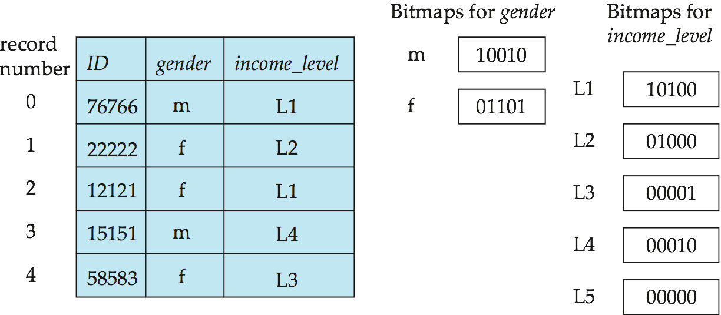
Bitmap Indices (Cont.)
In its simplest form a bitmap index on an attribute has a bitmap for each value of the attribute
  Bitmap has as many bits as records
  In a bitmap for value v, the bit for a record is 1 if the record has the value v for the attribute, and is 0 otherwise

Slide 66
Bitmap Indices (Cont.)
Bitmap indices are useful for queries on multiple attributes
  Not particularly useful for single attribute queries
Queries are answered using bitmap operations
  Intersection (and)
  Union (or)
  Complementation (not)
Each operation takes two bitmaps of the same size and applies the operation on corresponding bits to get the result bitmap
  E.g. 100110 AND 110011 = 100010
  100110 OR 110011 = 110111
  NOT 100110 = 011001
  Males with income level L1: 10010 AND 10100 = 10000
    Can then retrieve required tuples
    Counting number of matching tuples is even faster

Slide 67
Bitmap Indices (Cont.)
Bitmap indices generally very small compared with relation size
  E.g. if record is 100 bytes, space for a single bitmap is 1/800 of space used by relation
    If number of distinct attribute values is 8, bitmap is only 1% of relation size
Deletion needs to be handled properly
  Existence bitmap to note if there is a valid record at a record location
  Needed for complementation
    not(A=v): (NOT bitmap-A-v) AND ExistenceBitmap
Should keep bitmaps for all values, even null value
  To correctly handle SQL null semantics for NOT(A=v):
    Intersect above result with (NOT bitmap-A-Null)

Slide 68
Efficient Implementation of Bitmap Operations
Bitmaps are packed into words; a single word and (a basic CPU instruction) computes and of 32 or 64 bits at once
  E.g. 1-million-bit maps can be anded with just 31,250 instructions
Bitmaps can be used instead of Tuple-ID lists at leaf levels of B⁺-trees, for values that have a large number of matching records
  Worthwhile if > 1/16 of the records have that value, assuming a tuple-id is 64 bits
  Let N be the number of records in the relation
  The bitmap needs only 1 bit per record and N bits totally; but the list representation requires 64 bits per record or 64*N *(1/16)=4N bits totally
  Above technique merges benefits of bitmap and B⁺-tree indices

Slide 69
Index Definition in SQL
Create an index
  create index <index-name> on <relation-name>
  (<attribute-list>)
  E.g.: create index b_index on branch(branch_name)
Use create unique index to indirectly specify and enforce the condition that the search key is a candidate key
  Not really required if SQL unique integrity constraint is supported
To drop an index
  drop index <index-name>

Slide 70
Index in Oracle
Should be considered with table structure in the design phase
CREATE INDEX
  CREATE INDEX index_name
  ON table_name (column_names)
  TABLESPACE tbs_name
  CREATE BITMAP INDEX index_name ON table_name (column_names) TABLESPACE tbs_name
To browse all indexes of the user:
  select index_name, index_type from user_indexes;

Slide 71
When to Use Index
Create index on the fields that most often appear in where clauses
The field in which value will uniquely appear is proper to be indexed
When one field has not nice selectivity but several fields combined may have, it is appropriate to create bitmap indexes on them
The fields often used to join tables are doubtless candidates
The fields that may be modified frequently are not proper to be indexed

Slide 72
Index Issues
Index will not always improve the performance; sometimes it will result in the contrary side
Carefully consider:
  The frequency of query on a table; the frequency of accessing a field in queries
  The frequency of modification to a table
  Number of different values appearing in a field
Index design along with table design
Repeatedly test the efficiency before and after an index creation, and then decide whether to preserve it
Periodically check the efficiency and plan for reorganization or changing index type
  In Oracle: ALTER INDEX index_name REBUILD TABLESPACE tbs_name
We can use EXPLAIN PLAN (a utility tool in Oracle) to trace the usage of an index.

Slide 73
End of
Lecture 11

